Slide 1
QSCOUT
Jaqal

Slide 2
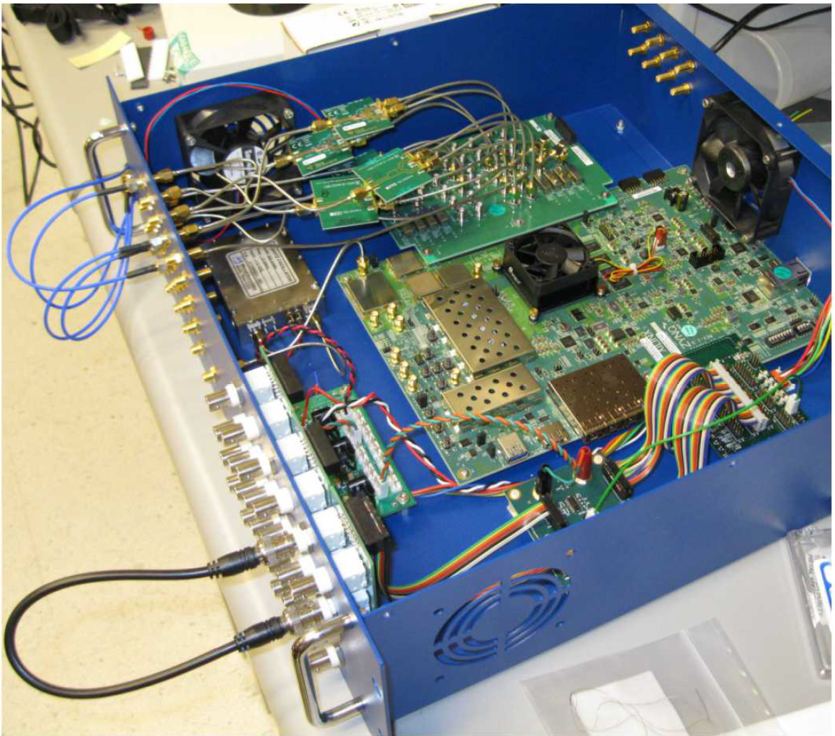
Sandia RFSoC System

Slide 3
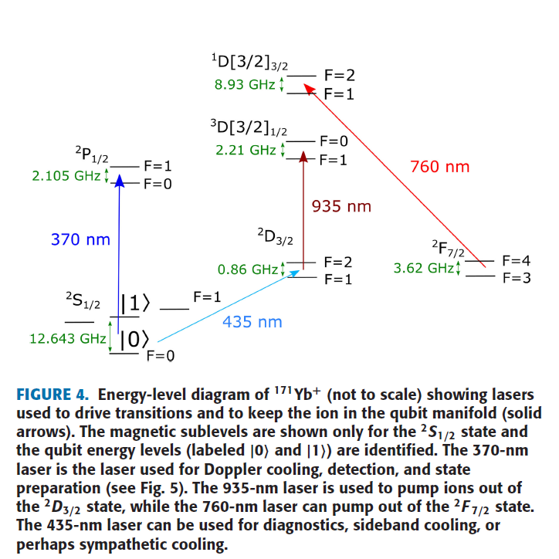
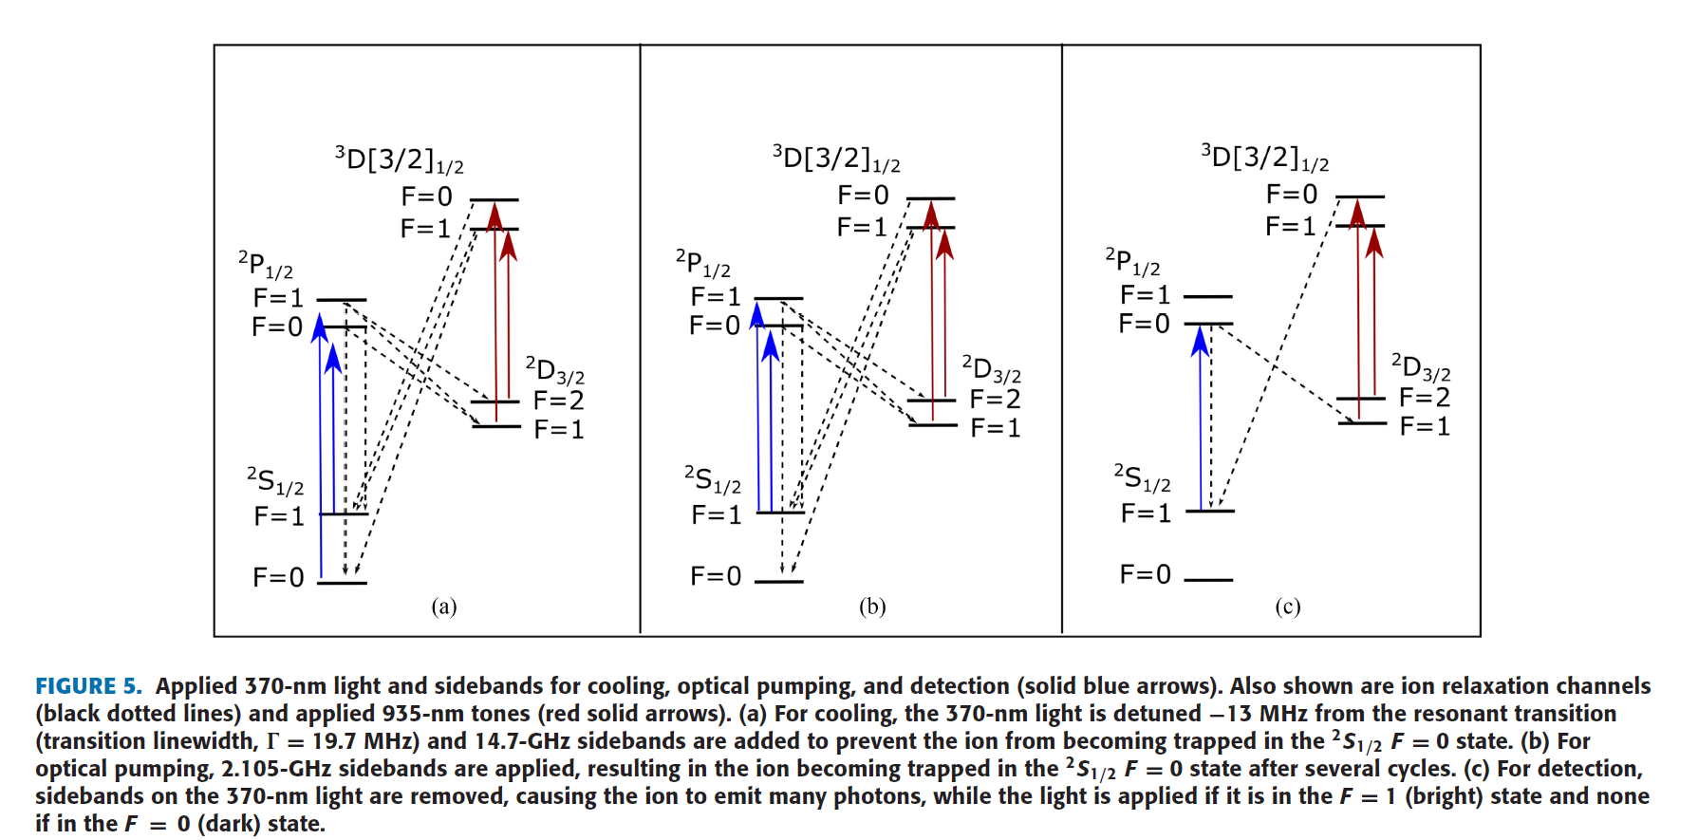
171Yb Energy Diagram

Slide 4
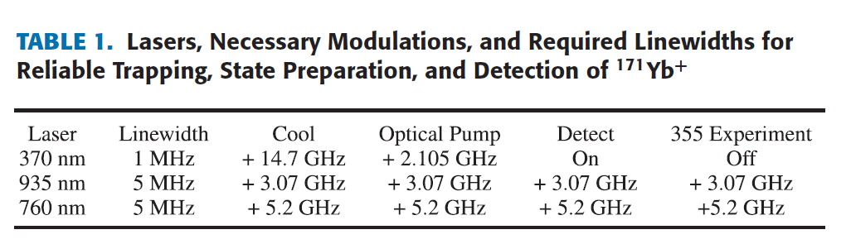
Laser frequency detuning

Slide 5
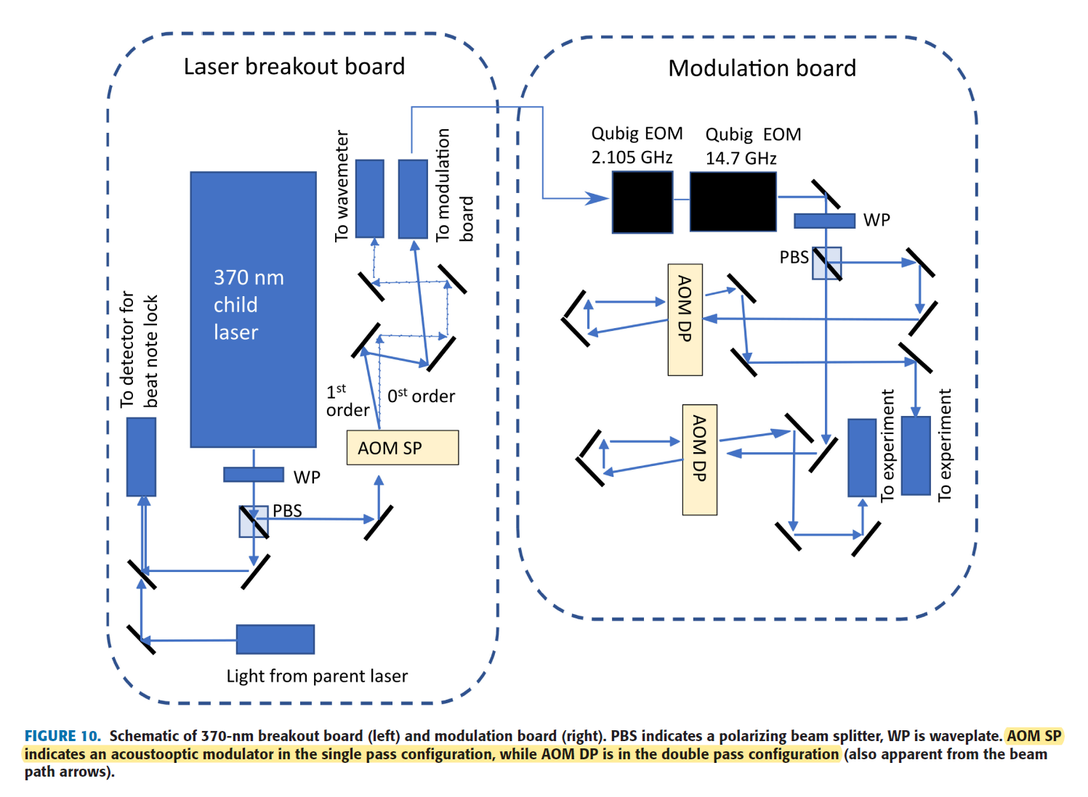
369nm setting

